Slide 1


RNS INSTITUTE OF TECHNOLOGY
Department of Computer Science & Engineering
Project Presentation -21CSP76
Online Voting System using Blockchain
Student Names:
Navaneeth N :1RN21CS098
Prarthana R :1RN21CS111
Rahul G Athreyas :1RN21CS118
Guide Name:
Ranjith V
Assistant Professor
Dept. of CSE, RNSIT
1

Slide 2
AGENDA
Introduction
Literature Survey
Problem Statement & Objectives
System Architecture/Block Diagram
Functional requirements
Low Level Design
High Level Design
Results
Conclusion
References
2
28/09 /2024

Slide 3
INTRODUCTION
Traditional voting faces errors and tampering; blockchain-based e-voting offers a secure alternative.
Blockchain ensures decentralized, tamper-proof, and transparent vote counts.
The system leverages the MERN stack to build an efficient web-based e-voting platform.
E-voting improves accessibility and reliability through internet technologies.
The solution enhances transparency, privacy, and security, addressing traditional voting flaws.
3
28/09 /2024

Slide 4
LITERATURE SURVEY
Paper Title | Authors | Year | Methodology/ Approach | Advantages | Disadvantages
Online Voting System | Noor Ahmed1 , Prof. Anupama Pattanasetty2 | 2024 | Create a secure blockchain voting system using smart contracts and adaptable consensus algorithms. | Enhanced security, transparency, and voter accessibility, alongside efficient processes and immutable records. | Technological barriers, potential disenfranchisement due to the digital divide, and complexity that may confuse voters.
BlockchainEnabledOnline-VotingSystem | AkhilShah, NishitaSodhia, ShrutiSaha | 2020 | The paper proposes an Android-based voting application with blockchain for vote recording and tallying. Security features include AES-128 encryption, SHA-256 hashing, and voter verification through fingerprint, OTP, and unique identification keys | The integration of AES-128 encryption, SHA-256, and blockchain ensures high levels of security, safeguarding voter data and vote integrity. | Implementing and maintaining such a sophisticated system with encryption and blockchain technology may be resource-intensive.
Decentralized E-Voting Portal Using Blockchain | Dr. Swapnil Jain,Kriti Patidar | 2019 | The proposed system uses smart contracts deployed on the Ethereum blockchain to manage voting securely. Development and testing were conducted using the Truffle framework, with Ganache as the Ethereum client and MetaMask as the browser wallet for interacting with the system​ | The use of blockchain and smart contracts enhances the security, integrity, and transparency of the voting process, ensuring that votes are immutable and verifiable. | Limited scalability and technical dependency hinder the system's ability to handle large-scale elections, as it relies heavily on blockchain frameworks like Ethereum, Truffle, Ganache, and MetaMask, requiring significant expertise for setup and maintenance.
Blockchain-Based E-Voting System | Friðrik Þ. Hjálmarsson, Gunnlaugur K. Hreiðarsson | 2018 | The paper evaluates blockchain as a service for developing a distributed e-voting system, using a case study approach to assess the potential of distributed ledger technologies for improving security and reducing costs in national elections. | The blockchain-based system improves the security and transparency of the voting process by leveraging distributed ledger technology. | Implementing a blockchain-based election system on a national scale may face technical and operational challenges due to its complexity.
E-voting systems: A tool for e-democracy | Emad ABU-SHANAB, Michael KNIGHT and Heba REFAI | 2010 | Explores e-voting adoption using the Technology Acceptance Model (TAM), emphasizing usefulness, ease of use, and trust, along with global experiences focused on security and efficiency. | The e-voting system enhances the accuracy and reduces errors in the election process, offering more convenience​ | The adoption of e-voting systems is inconsistent across regions, with some countries using them while others resist due to concerns like security​
4

Slide 5
PROBLEM STATEMENT
Existing e-voting systems lack security, transparency, and scalability.
The proposed solution uses blockchain to ensure data integrity, voter privacy, and transparency.
Blockchain enables immutable vote records and voting status tracking.
The MERN stack powers a responsive frontend, while MongoDB stores non-sensitive election data.
5
28/09 /2024

Slide 6
OBJECTIVES
To build a secure and transparent e-voting system using blockchain technology.
To create an intuitive and user-friendly interface for the voting process using the MERN stack.
To ensure the integrity of votes by decentralizing the storage of votes and the status of the voting process.
To provide real-time monitoring and secure, anonymous data storage.
To overcome limitations of existing e-voting systems, particularly in terms of scalability and security.
5
28/09 /2024

Slide 7
FUNCTIONAL REQUIREMENTS
User Authentication: Authenticates voters securely using methods like multi-factor authentication, providing an authentication token or error.
Voting: Allows voters to cast their votes securely and privately, confirming the vote cast.
Vote Counting: Automatically tallies votes from the blockchain, ensuring security.
Result Display: Shows real-time election results with visual representations like charts and graphs.
6
28/09 /2024

Slide 8
NON FUNCTIONAL REQUIREMENTS
Performance: Handle a specified number of concurrent users with response times under 2 seconds.
Scalability: Support scaling to accommodate increasing voter numbers during peak periods.
Security: Ensure data encryption in transit and at rest, with protection against vulnerabilities like SQL injection, DDoS, and unauthorized access.
Usability: Provide an intuitive and accessible user interface for all demographics.
Reliability: Implement strong backup and disaster recovery solutions.
6
28/09 /2024

Slide 9
USER REQUIREMENTS
Voter Experience: Voters should easily register, authenticate, and cast their votes via a user-friendly interface with immediate confirmation.
Transparency: Provide real-time updates on election status and results, allowing voters to verify their vote was counted.
Security: Ensure voters feel confident their votes are secure, private, and tamper-proof. This is achieved by hashing their passwords
28/09 /2024
6

Slide 10

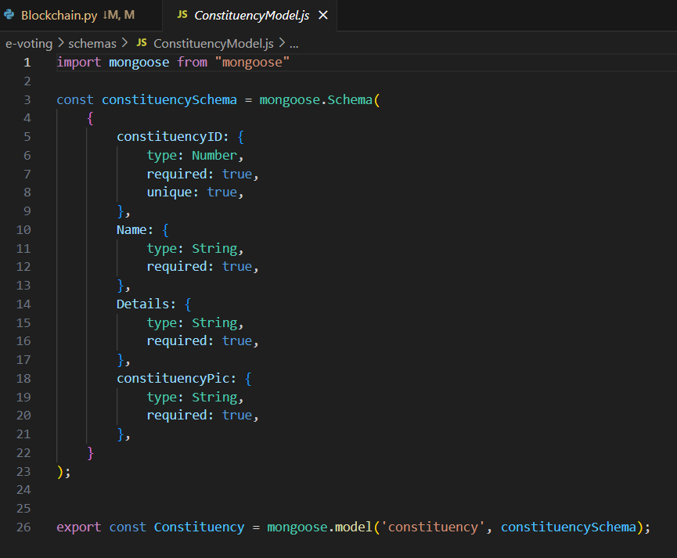
LOW LEVEL DESIGN

Slide 11
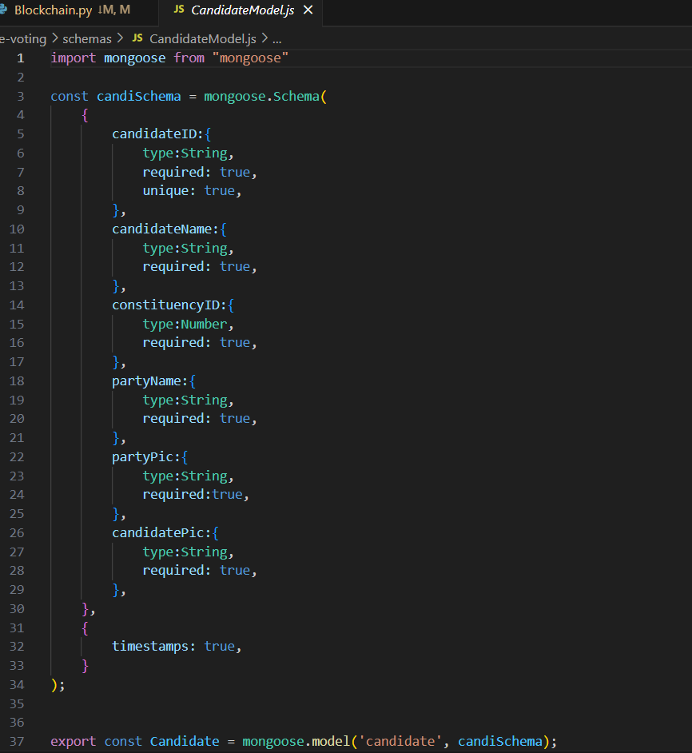
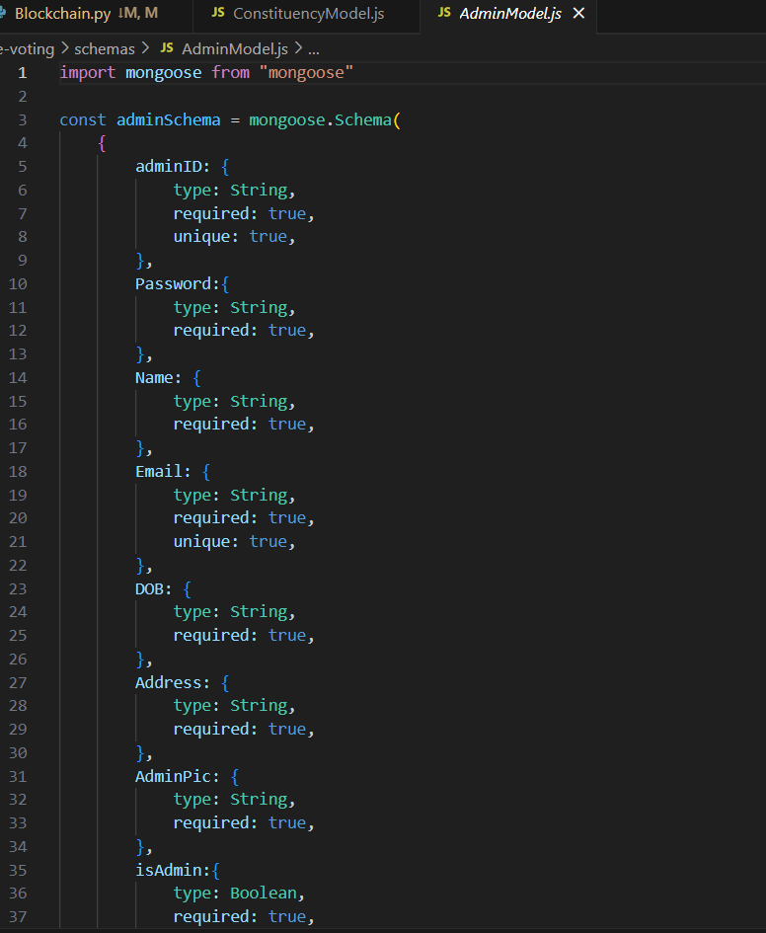

Slide 12
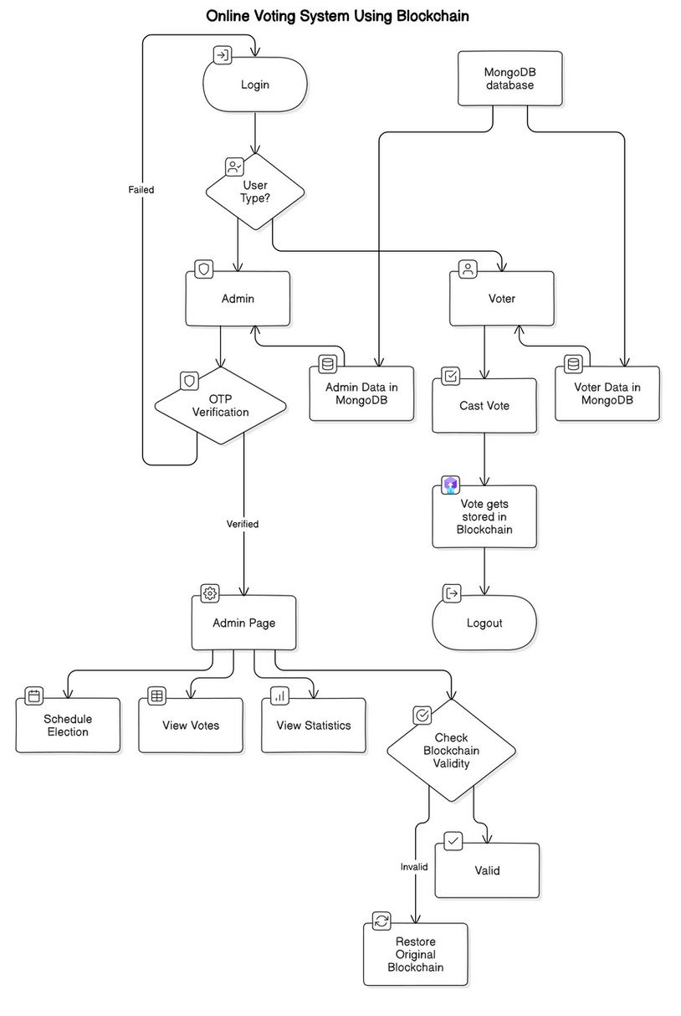
HIGH LEVEL DESIGN

Slide 13
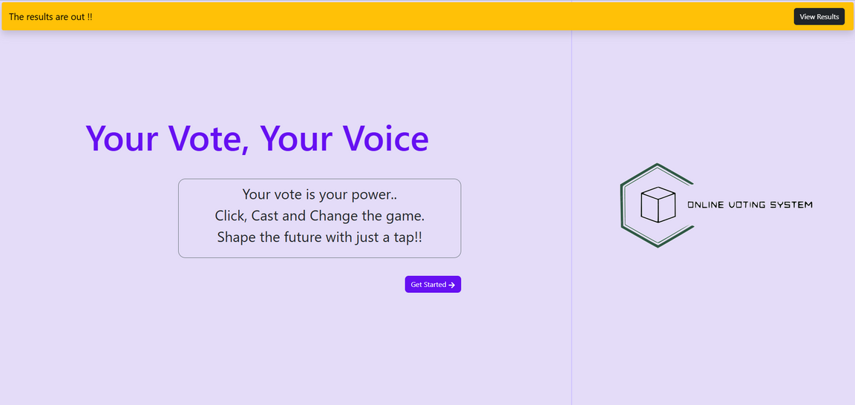
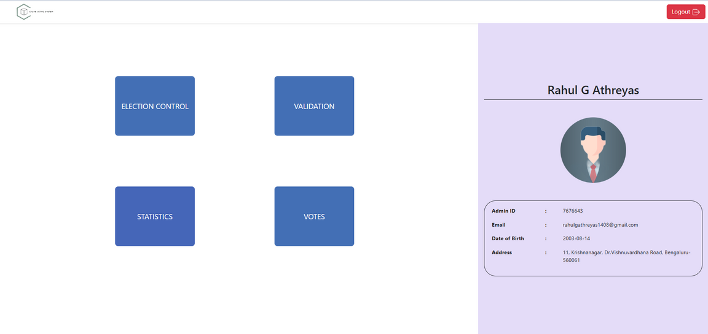
RESULT

Slide 14
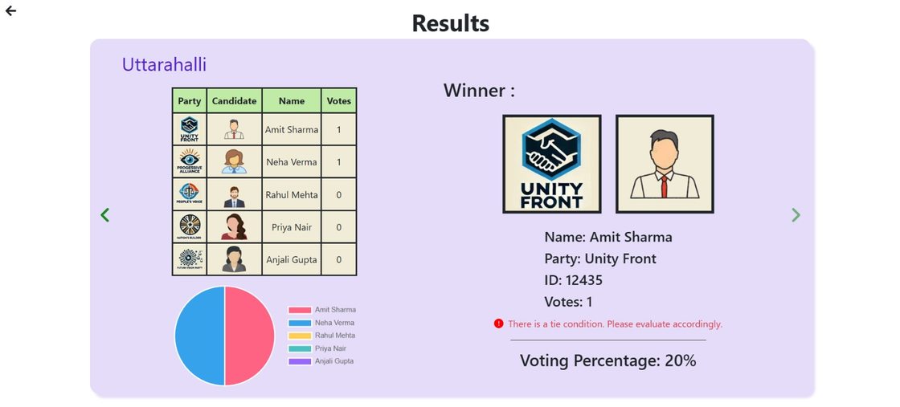
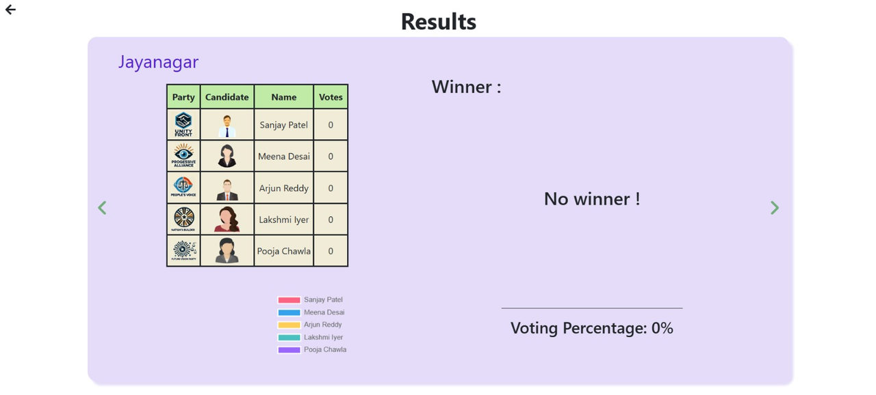
RESULT

Slide 15
CONCLUSION
Conclusion
The system combines blockchain and the MERN stack to create a secure, decentralized, and user-friendly e-voting platform.
It addresses key issues like security, transparency, and scalability.
Applications
Can be used in government and corporate elections for tamper-proof, trustworthy voting.
Advantages
Ensures data integrity, enhances transparency, and supports large-scale elections while protecting voter privacy.
Future Work
Improve scalability, mobile compatibility, and integrate advanced cryptography for enhanced security.
28/09 /2024
8

Slide 16
REFERENCES
1.Kaliyamurthie, K. P., et al. "Highly secured online voting system over network." Indian Journal of Science and Technology 6.6 (2013): 1-6.
2. Jayson Falkner, Ben Galbraith, Romin Irani, Casey Kochmer, Sathya Narayana Panduranga, Krishnaraj
3. Perrumal, John Timney, Meeraj Moidoo Kunnumpurath, (2001), Beginning JSP Web Development,Wro
4. AbuShanab, E. (2005). Internet Banking in Jordan: The Unified Theory of Acceptance and Use of Technology (UTAUT) Perspective. A PhD dissertation at Southern Illinois University Carbondale, 2005. Supervisor: John Pearson, SIUC, USA.
5. Sos.ca.gov. (2007). Top-to-Bottom Review | California Secretary of State.
Available at: http://www.sos.ca.gov/elections/voting-systems/oversight/ top-bottom-review.
6. Hjálmarsson, Friðrik Þ., et al. "Blockchain-based e-voting system." 2018 IEEE 11th international conference on cloud computing (CLOUD). IEEE, 2018.
7. Patidar, Kriti, and Swapnil Jain. "Decentralized e-voting portal using blockchain." 2019 10th International Conference on Computing, Communication and Networking Technologies (ICCCNT). IEEE, 2019.
28/09 /2024

